Slide 1

NLP Networks Long Short Term Memory (LSTM)
In this presentation, you will learn about Long Short Term Memory (LSTM), its architecture, and how it has revolutionized Natural Language Processing (NLP).

Slide 2
Need for Memory in Sequential Data
The Challenge
The Solution
Traditional Recurrent Neural Networks (RNNs) suffer from vanishing or exploding gradients, making it hard for them to store long-term memory in sequential data models.
LSTMs address this challenge by introducing memory cells that keep track of past information, making them ideal for NLP applications such as machine translation.

Slide 3
LSTM Cell Architecture
Input Gate
Forget Gate
A gate that determines which values to update and how much.
A gate that removes irrelevant information from the cell state.
Output Gate
Memory Cell
A gate that controls the amount of information that flows out of the cell state.
A cell that stores long-term dependencies.

Slide 4

LSTM vs. Vanilla RNN
1
Vanilla RNN
Has a simple architecture well-suited for small datasets, but cannot store long-term dependencies in sequential data.
2
LSTM
Has a more complex architecture that allows for the storage and retrieval of long-term dependencies in sequential data, making it ideal for NLP tasks.

Slide 5
Solving Long-Term Dependencies
1
Backpropagate through Time (BPTT)
LSTM addresses the vanishing and exploding gradient problem of traditional RNNs, so BPTT can be performed effectively.
Gradient Clipping
2
LSTM introduces a parameter called gradient clipping that reduces the gradient's magnitude, limiting the risk of exploding gradients.
3
Gating Mechanism
LSTM accomplishes heavy computation by utilizing "gates" that independently control the flow of information through the network.

Slide 6
Peephole Connections in LSTM
What Are Peephole Connections?
Why Are they Useful?
Peephole connections are additional connections between the cell state and gates that directly interact with one another.
Peephole connections improve the LSTM's performance by allowing it to directly influence the gating mechanism's activation.

Slide 7
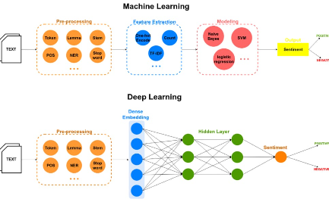
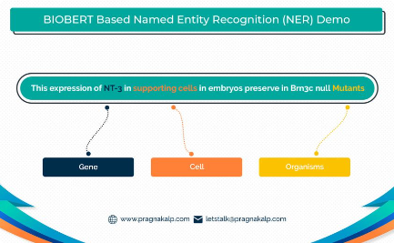
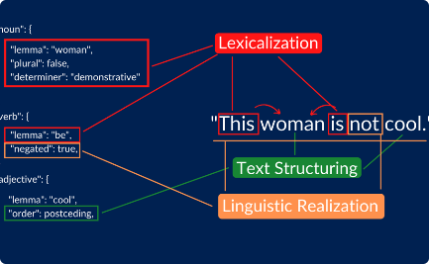
Applications of LSTM in NLP
Sentiment Analysis using LSTM
Named Entity Recognition with LSTM
Language Generation with LSTM
A task that involves categorizing text as positive, negative, or neutral.
A task that involves identifying and classifying entities in a text into predefined categories.
The ability to generate meaningful phrases or sentences in a human language, such as chatbots or auto-correction on mobile devices.

Slide 8
Challenges and Trends in LSTM
Challenges
Trends
Overfitting
Attention Mechanisms
Interpretability
Transfer Learning
Runtime Performance
Federated Learning

Slide 9
Conclusion
Key Takeaways:
Key Challenges:
LSTM is an architecture that allows for the storage and retrieval of long-term memory to handle sequential data better.
Backpropagation Through Time (BPTT) has some computational and performance limitations.
LSTM has found numerous use cases in NLP, including Sentiment Analysis, Named Entity Recognition, and Language Generation.
Interpretability of the model is still a challenge.

